Slide 1
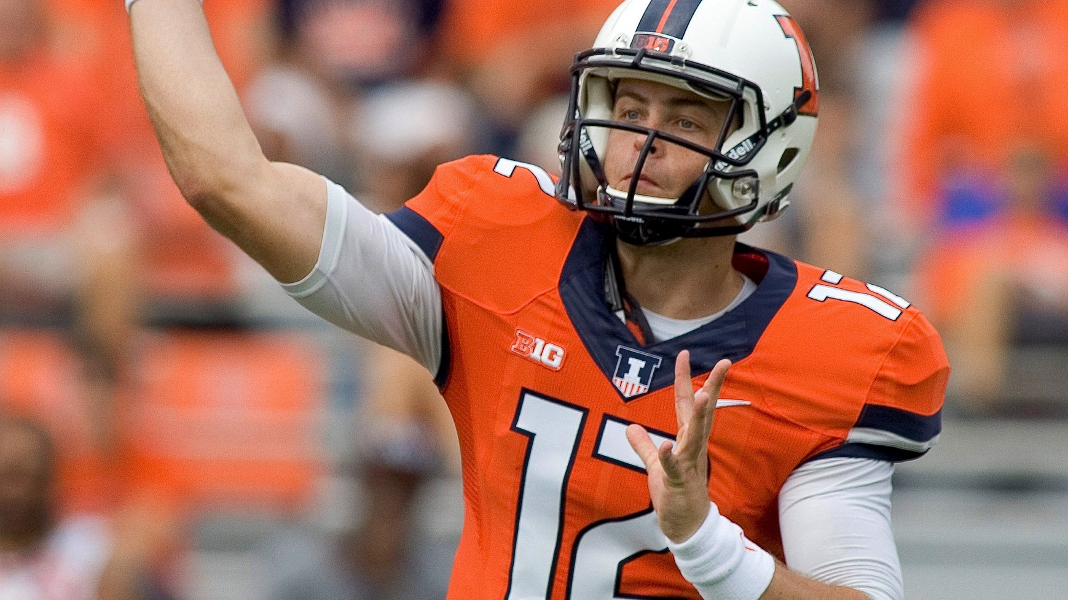

A Bayesian Approach to Predicting NFL Player Scores in Fanduel Tournaments
Aaron Ray (aaronwr2)
Michael Chan (mhchan3)
Kiomars Nassiri (nassiri2)
STAT 578 - ABM

Slide 2

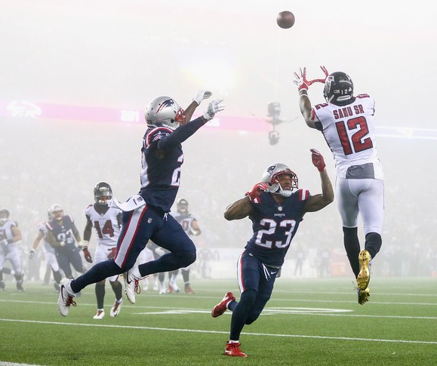
Fantasy Football
Participants in a Fantasy Football game act as the managers of a virtual football team and try to maximize their points by picking up the best line-up.
Points are given based on actual performance of players in real-world competition.
Each team is allowed a pre-determined number of players on its roster, as well as a specified number at each position that can or must be used in each game (the "starters").

Slide 3


FanDuel
For the purpose of this project we have chosen to work with the data gathered from the FanDuel internet company.
“FanDuel is a web-based fantasy sports game and with 6 million registered users and is the second largest daily fantasy sports company (as measured by entry fees and user base) in the daily fantasy sports industry” – Wikipedia

Slide 4
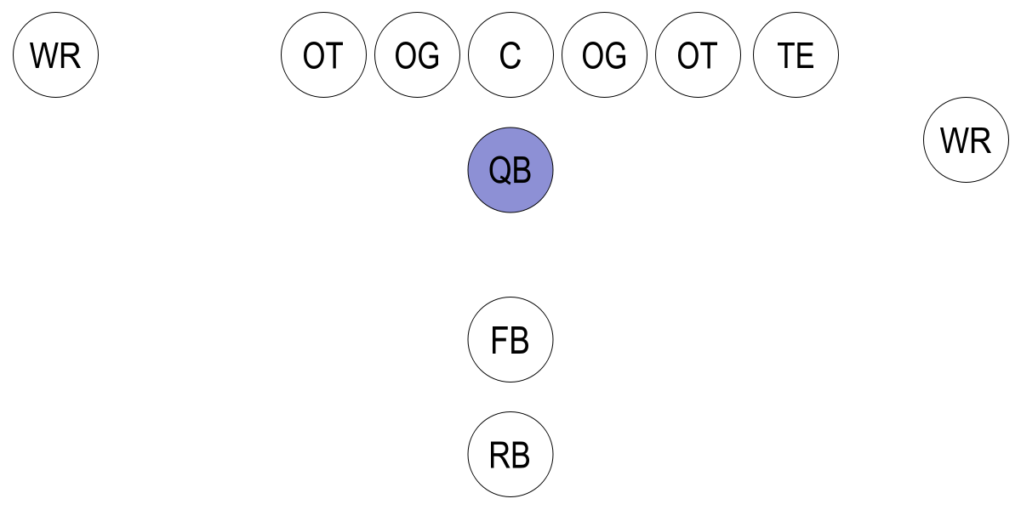
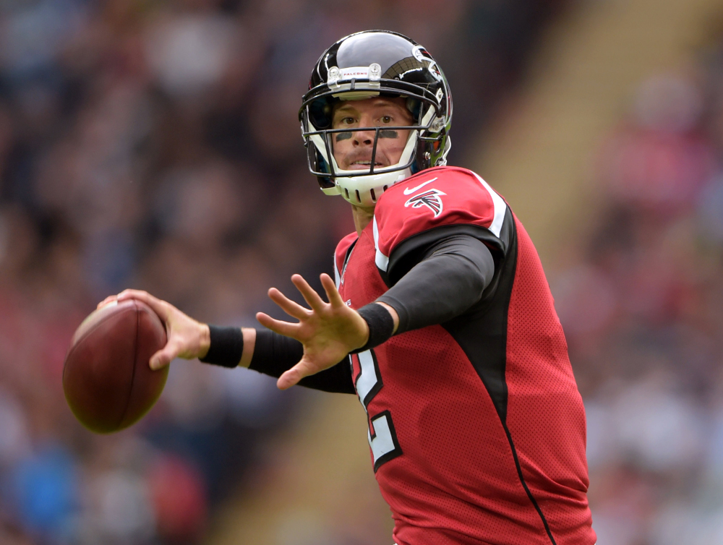
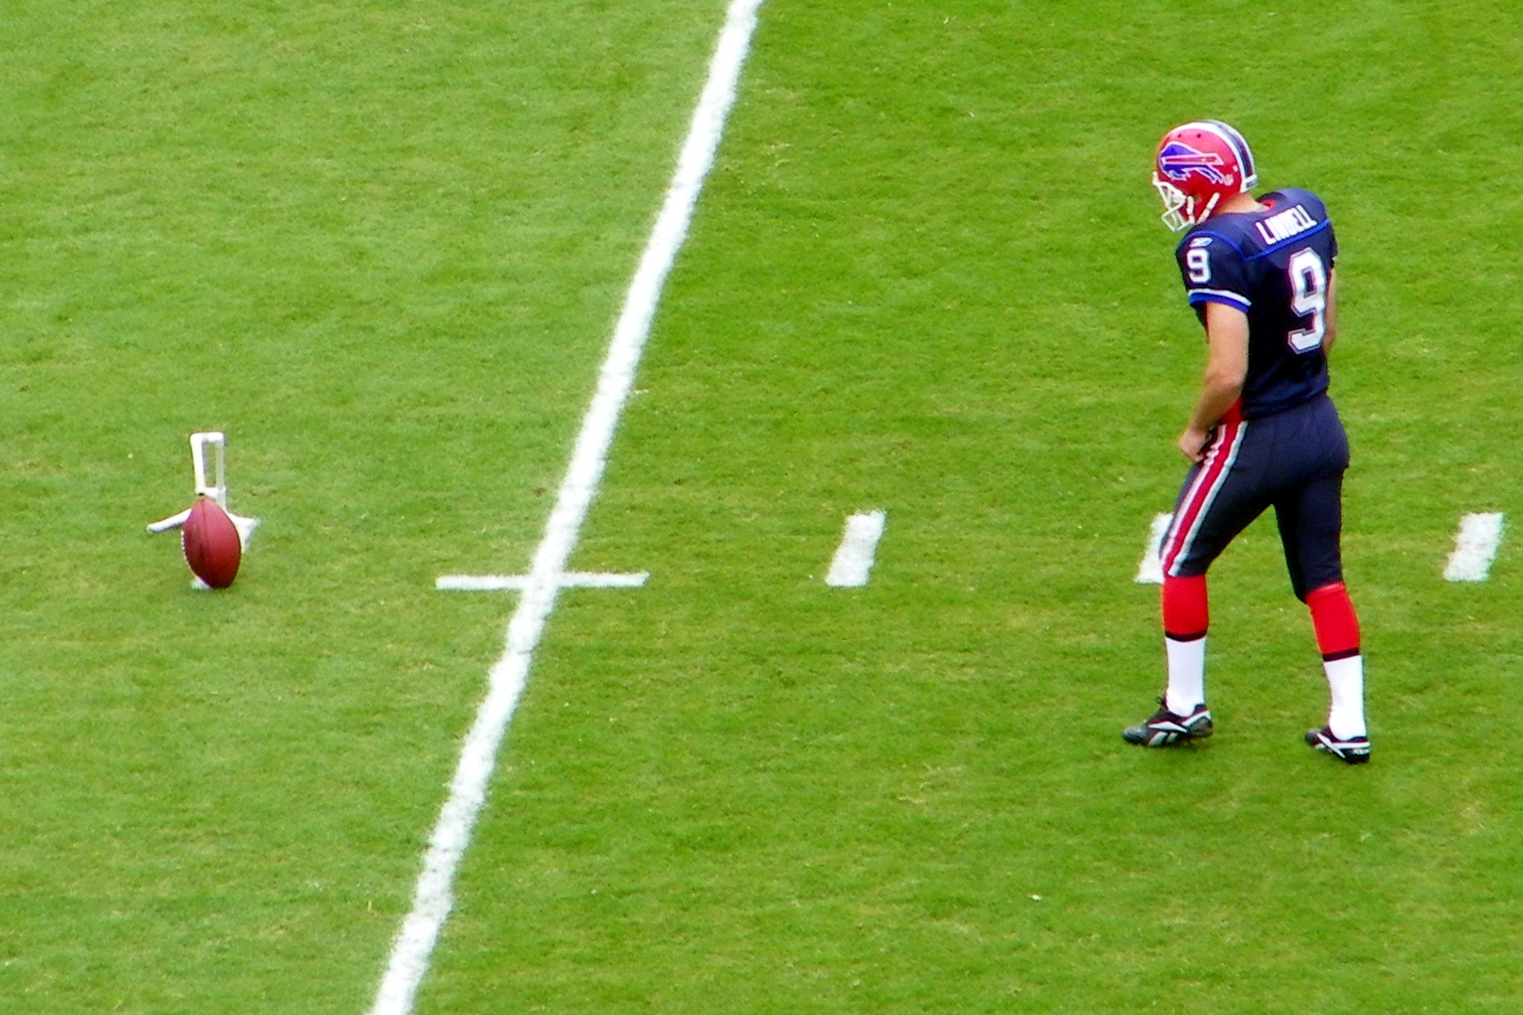
Research Questions & Objective
“QBs or Quarterbacks are members of the offensive team and line up directly behind the offensive line. They are considered the leader of the offensive team.” – Wikipedia
We have leveraged a Hierarchical Bayesian approach with the Markov Chain Monte Carlo method to predict the fantasy points likely to be scored by an NFL QB and PK in any given game.
In this project we are interested to know:
What features can help us effectively predict Fanduel points players receive in a future match?
How reliable are the predictions for the future performance of players?
“PKs or Placekickers are responsible for the kicking duties of field goals and extra points.” – Wikipedia

Slide 5

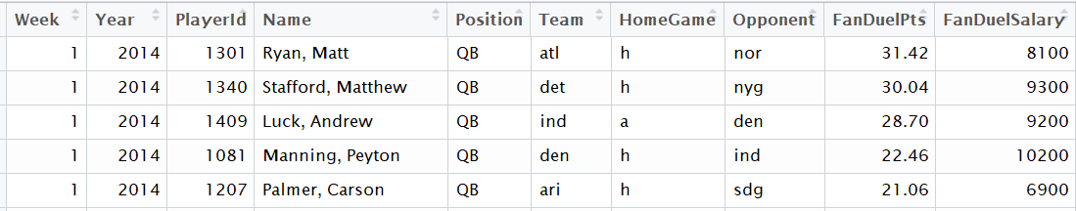
Dataset – Fanduel Stats
Historical data on the performance of the players is extracted from the RotoGuru website.
Seasons 2014 – 2017, Weeks 1- 16
Data includes information about:
The Fanduel points received by each player
Player’s position in a given week,
Player’s opponent team in a given week
Etc.
Raw Data Fields | Description
Week | Match Week
Year | Match Year
Player ID | Player ID
Name | Player Name (Last, First)
Position | Player’s Position
Team | Player’s Team
HomeGame | Home/Away Indicator
Opponent | Player’s Opponent Team
FanDuelPts | FanDuel Points
FandDuelSalary | FanDuel Salary

Slide 6
Data Preparation and Wrangling
Raw data, then, undergoes different data preparation processes as follows:
Data Cleansing:
Removing invalid records, binarizing indicator columns, Fixing naming issues, etc.
Data Wrangling:
6-week running mean and SD of PAPs.
5-week running mean and SD of the points scored by players who play a certain position for a given team.
Offensive and Defensive Ranks (?)
Points Allowed to Position (PAP): This metric represents the typical total points that each player’s opponent has allowed to players of that position in any given game.

Slide 7
Overview of the Bayesian Model
Response Variable:
FanDuel Points Received
Predictor Variables:
5-week running mean of the points scored
6-week running mean of PAPs.
Position
Home Advantage Indicator
Rank: The rank of a player based on recent performance.

Slide 8
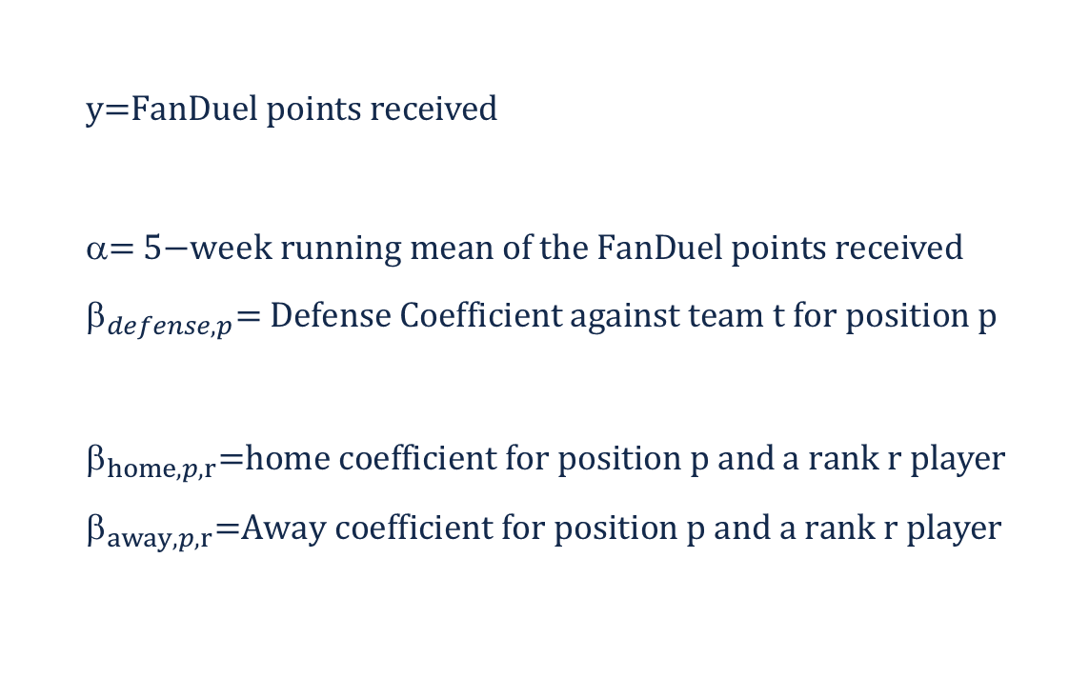
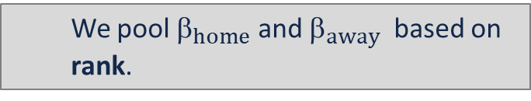
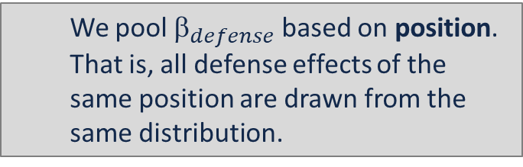
Sampling Model
We have assumed performance (FanDuel points) is normally distributed around a true mean value
$$\text{y}\text{=}\text{FanDuel} \text{points} \text{received}$$
$$\text{= }\text{5}\text{−}\text{week} \text{running} \text{mean} \text{of} \text{the} \text{FanDuel} \text{points} \text{received}$$
$${\text{}}_{defense,p}\text{= }\text{Defense} \text{Coefficient} \text{against} \text{team} \text{t} \text{for} \text{position} \text{p}$$
$${\text{}}_{home,p,r}\text{=}\text{home} \text{coefficient} \text{for} \text{position} \text{p} \text{and} \text{a} \text{rank} \text{r} \text{player}$$
$${\text{}}_{away,p,r}\text{=}\text{Away} \text{coefficient} \text{for} \text{position} \text{p} \text{and} \text{a} \text{rank} \text{r} \text{player}$$
We pool ${\text{}}_{defense}$based on position. That is, all defense effects of the same position are drawn from the same distribution.
We pool ${\text{}}_{home}$ and ${\text{}}_{away}$ based on rank.

Slide 9
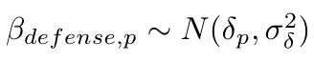
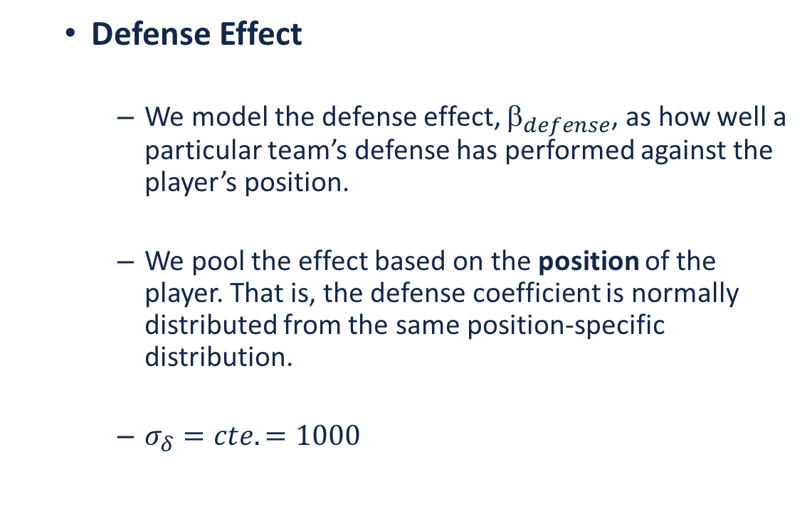
Sampling Model (Cont’d)
Defense Effect
We model the defense effect, ${\text{}}_{defense}$, as how well a particular team’s defense has performed against the player’s position.
We pool the effect based on the position of the player. That is, the defense coefficient is normally distributed from the same position-specific distribution.
$σ_{δ}=cte.=1000$
X
η
β_{home}
ρ
β_{away}
y
σ_{y}²
Rank
N
δ
β_{defense}
Position

Slide 10
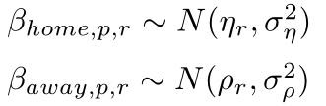
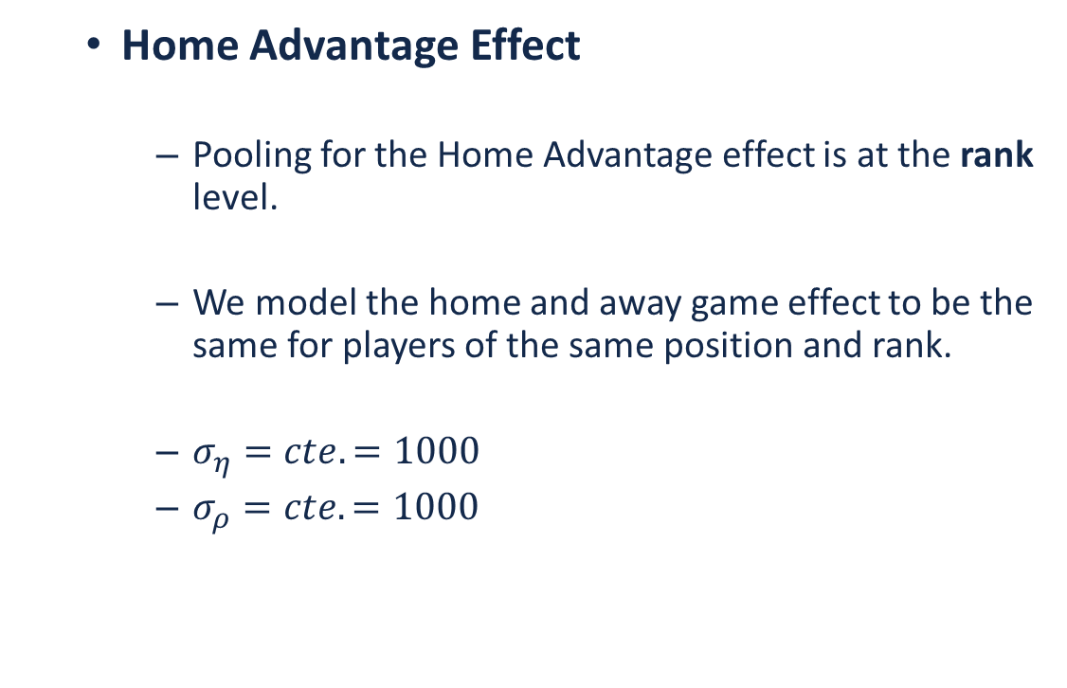
Sampling Model (Cont’d)
Home Advantage Effect
Pooling for the Home Advantage effect is at the rank level.
We model the home and away game effect to be the same for players of the same position and rank.
$σ_{η}=cte.=1000$
$σ_{ρ}=cte.=1000$
X
η
β_{home}
ρ
β_{away}
y
σ_{y}²
Rank
N
δ
β_{defense}
Position

Slide 11
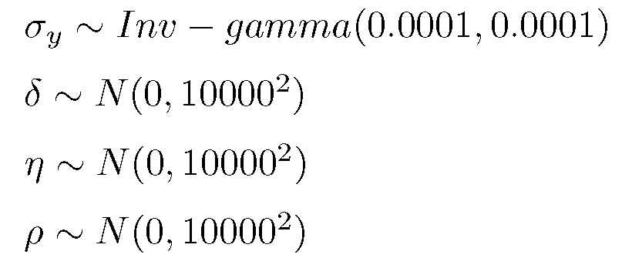
Priors
We have chosen our prior distributions to be proper (but diffuse and non-informative):
X
η
β_{home}
ρ
β_{away}
y
σ_{y}²
Rank
N
δ
β_{defense}
Position

Slide 12
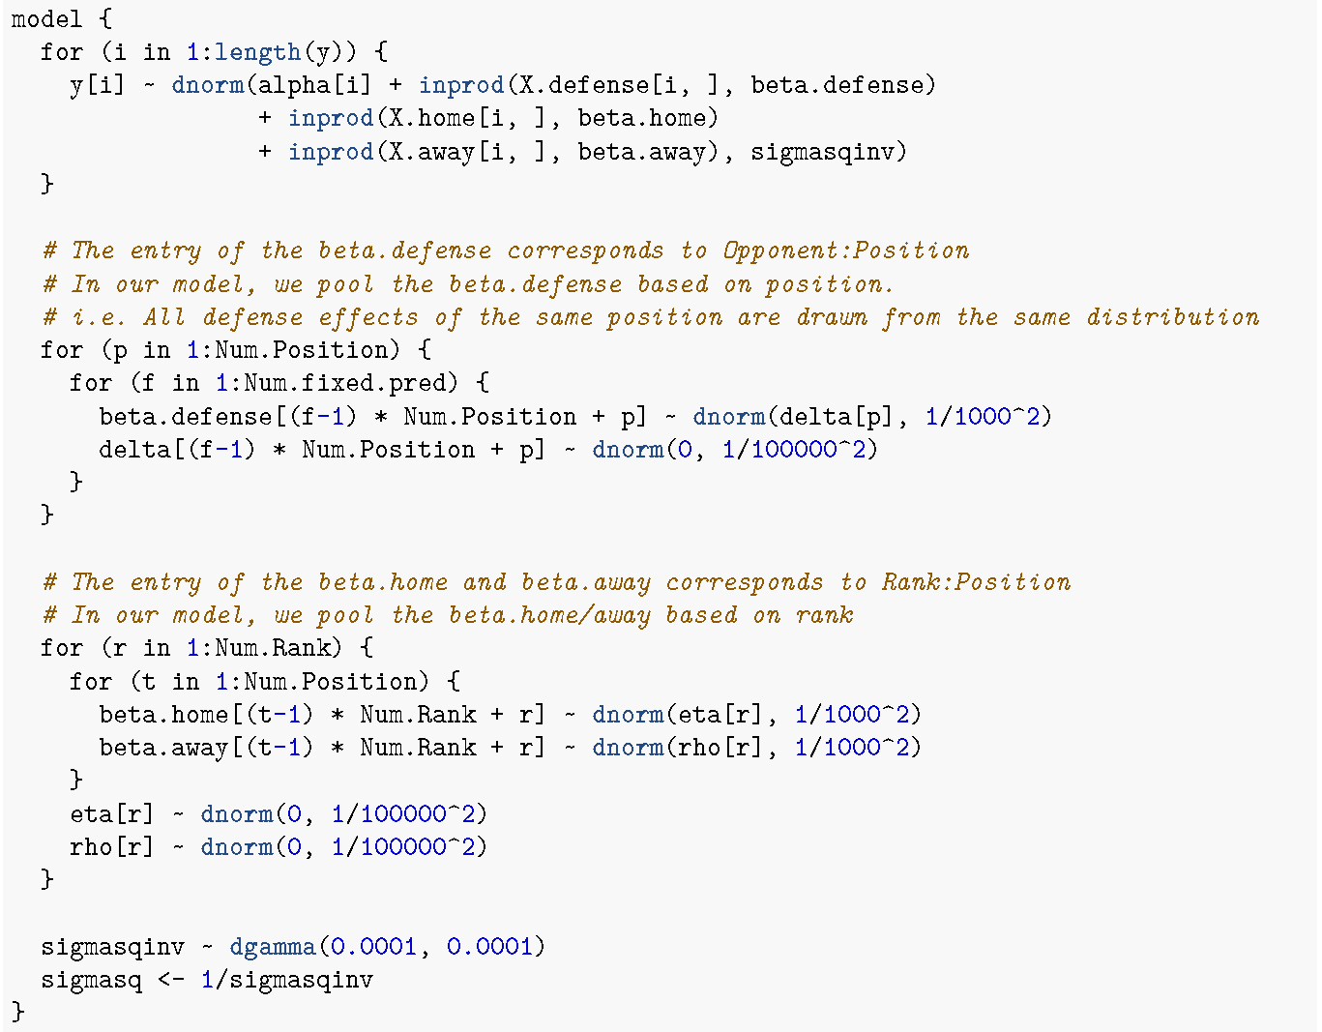
BUG Model Specification
X
η
β_{home}
ρ
β_{away}
y
σ_{y}²
Rank
N
δ
β_{defense}
Position

Slide 13
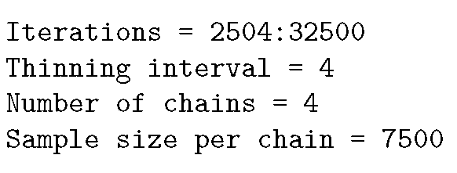
Modeling Process & Results
Note: Due to significant roster changes that usually happen during the off-season period, it was decided not to use data across seasons.
Initialization: Set up initializations for 4 chains with different over-dispersed starting points.
Modeling Data: 2016 data is used for modeling as it is the most recent year with a full reason.
Prediction Data: Last week of 2016 is set aside to test model prediction accuracy.
Convergence: Convergence diagnostics are conducted using trace plots and the Gelman statistic.
Effective Sample Size: The threshold for effective sample size is assumed to be 400.

Slide 14
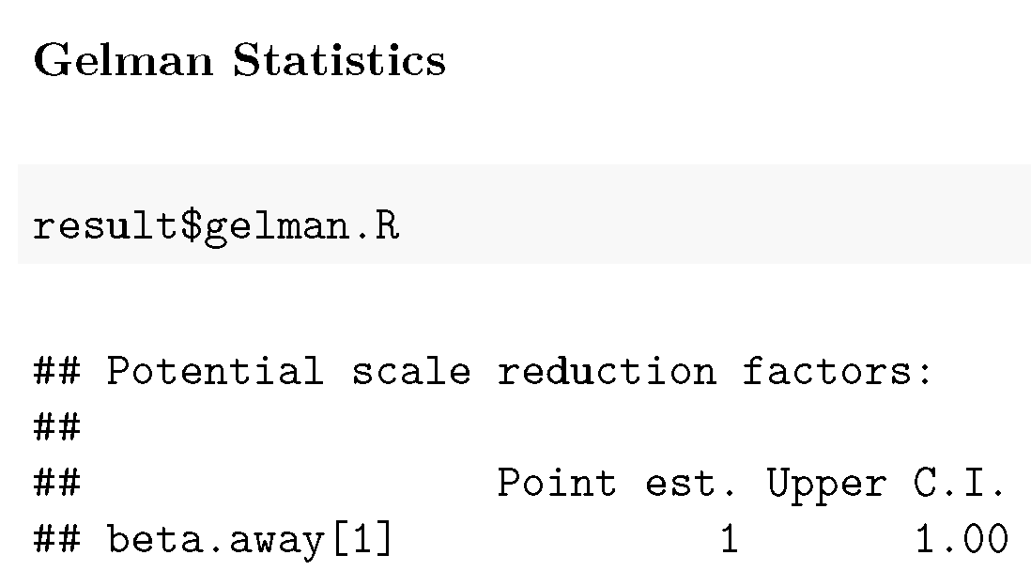
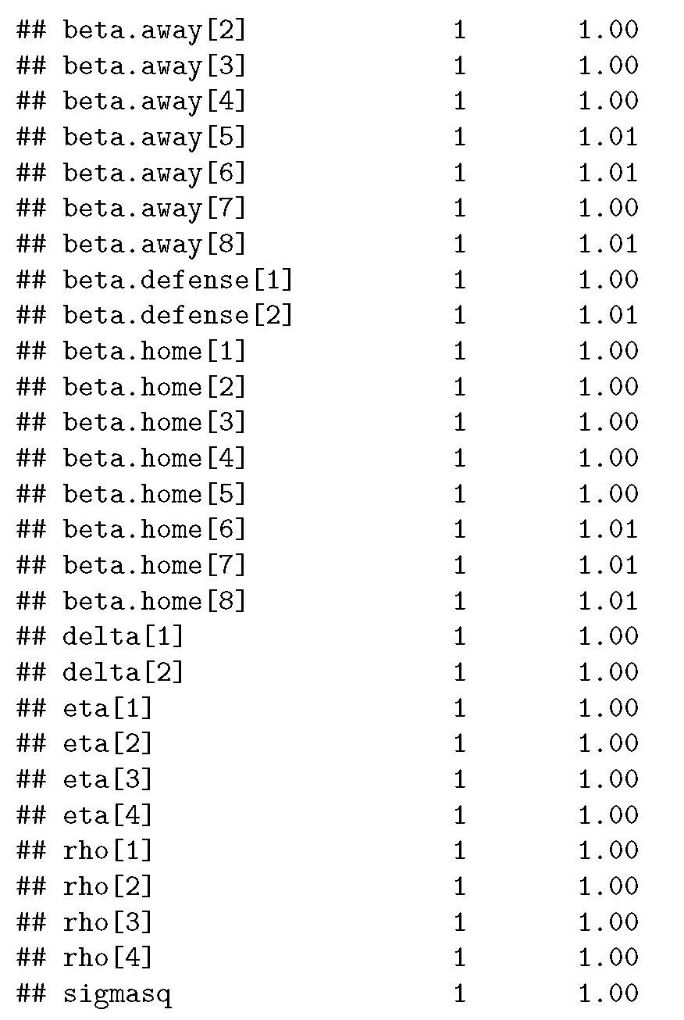
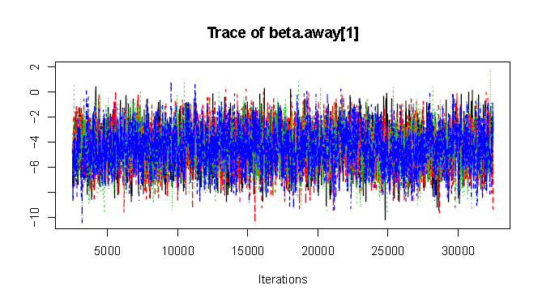
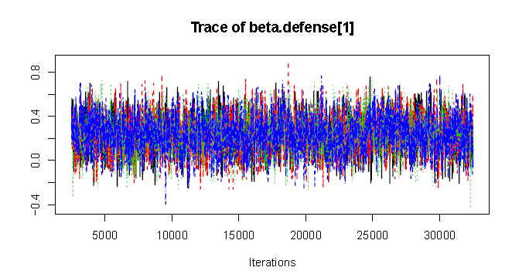
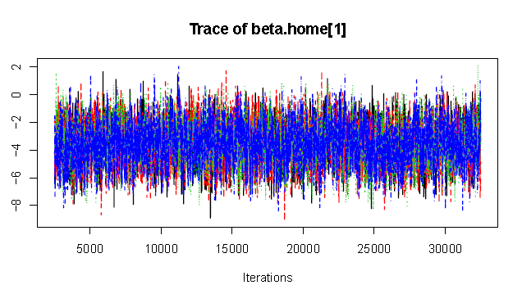
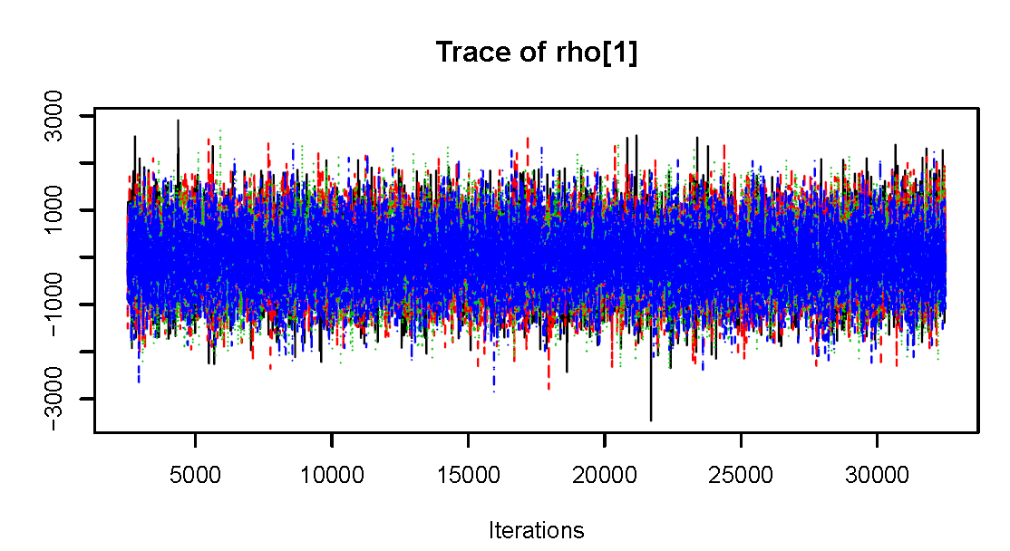
Modeling Process & Results (Cont’d)
Convergence Diagnostics:
Trace Plots of all of the parameters show good distribution convergence. Here are a few of the trace plots:

Slide 15
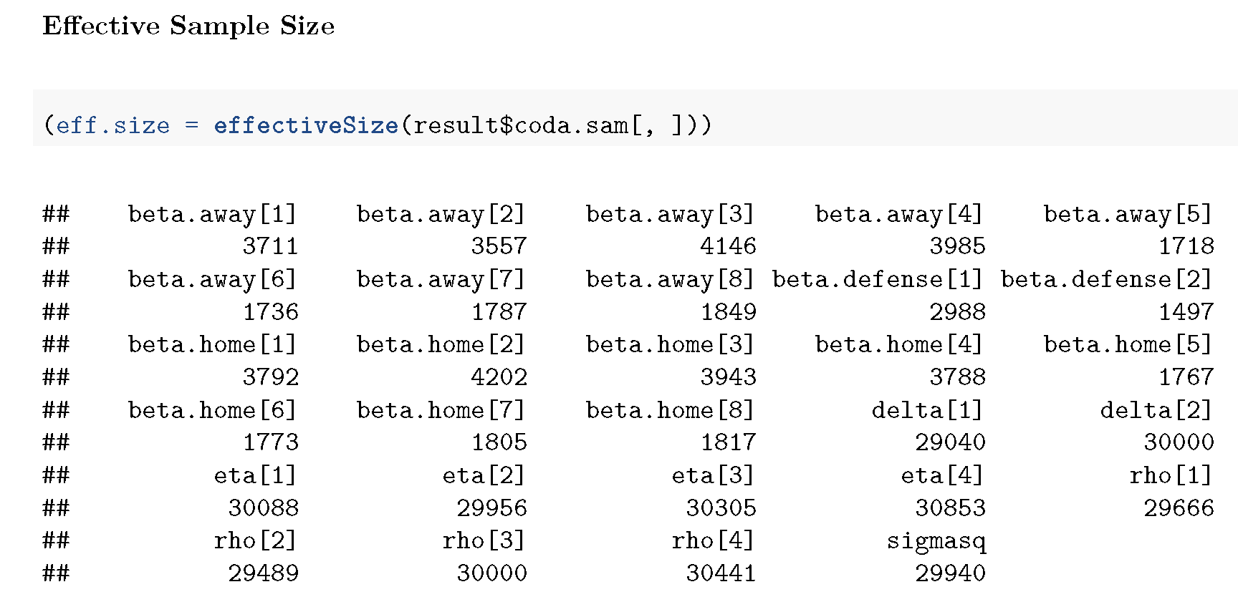
Modeling Process & Results (Cont’d)
Effective Sample Size:
Effective sample size of all parameters are greater than the threshold (400) and seem adequate.

Slide 16
Modeling Process & Results (Cont’d)
Model Summary Results:
Here are some of the summary results for the model parameters:

Slide 17
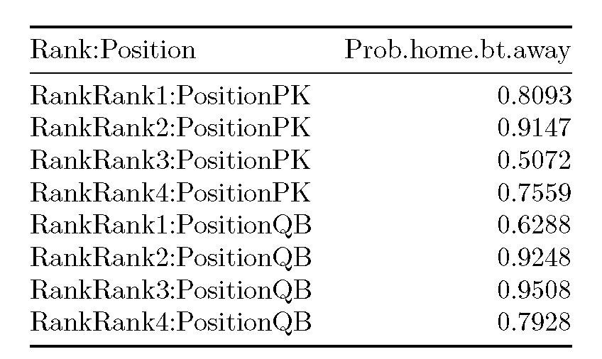
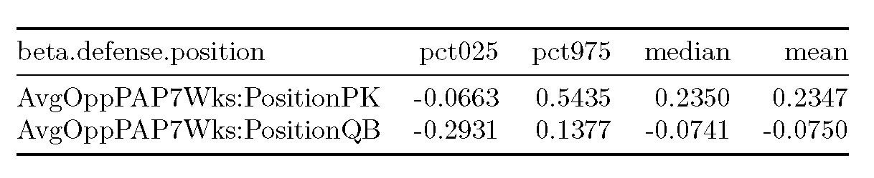
Model Assessment
General Posterior Results Check:
Probability of performing better in Home games:
As expected, players in different ranks and positions are performing better in Home games in comparison with Away games based on Posterior.
Probability of performing better when playing against teams with worse defense records:
The median for PKs are positive, as expected, but median for QBs are slightly negative; meaning that QBs actually score less points against teams with not-so-well defensive records.

Slide 18
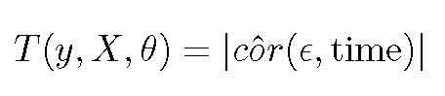
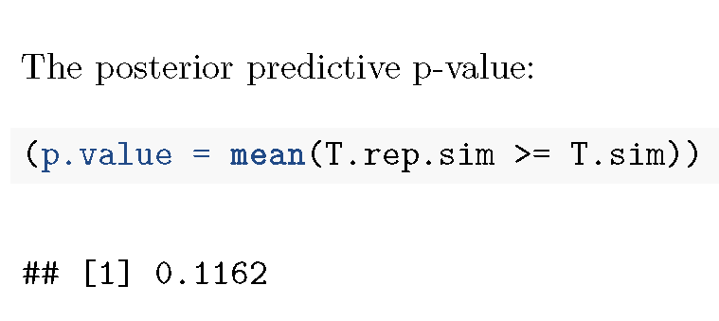
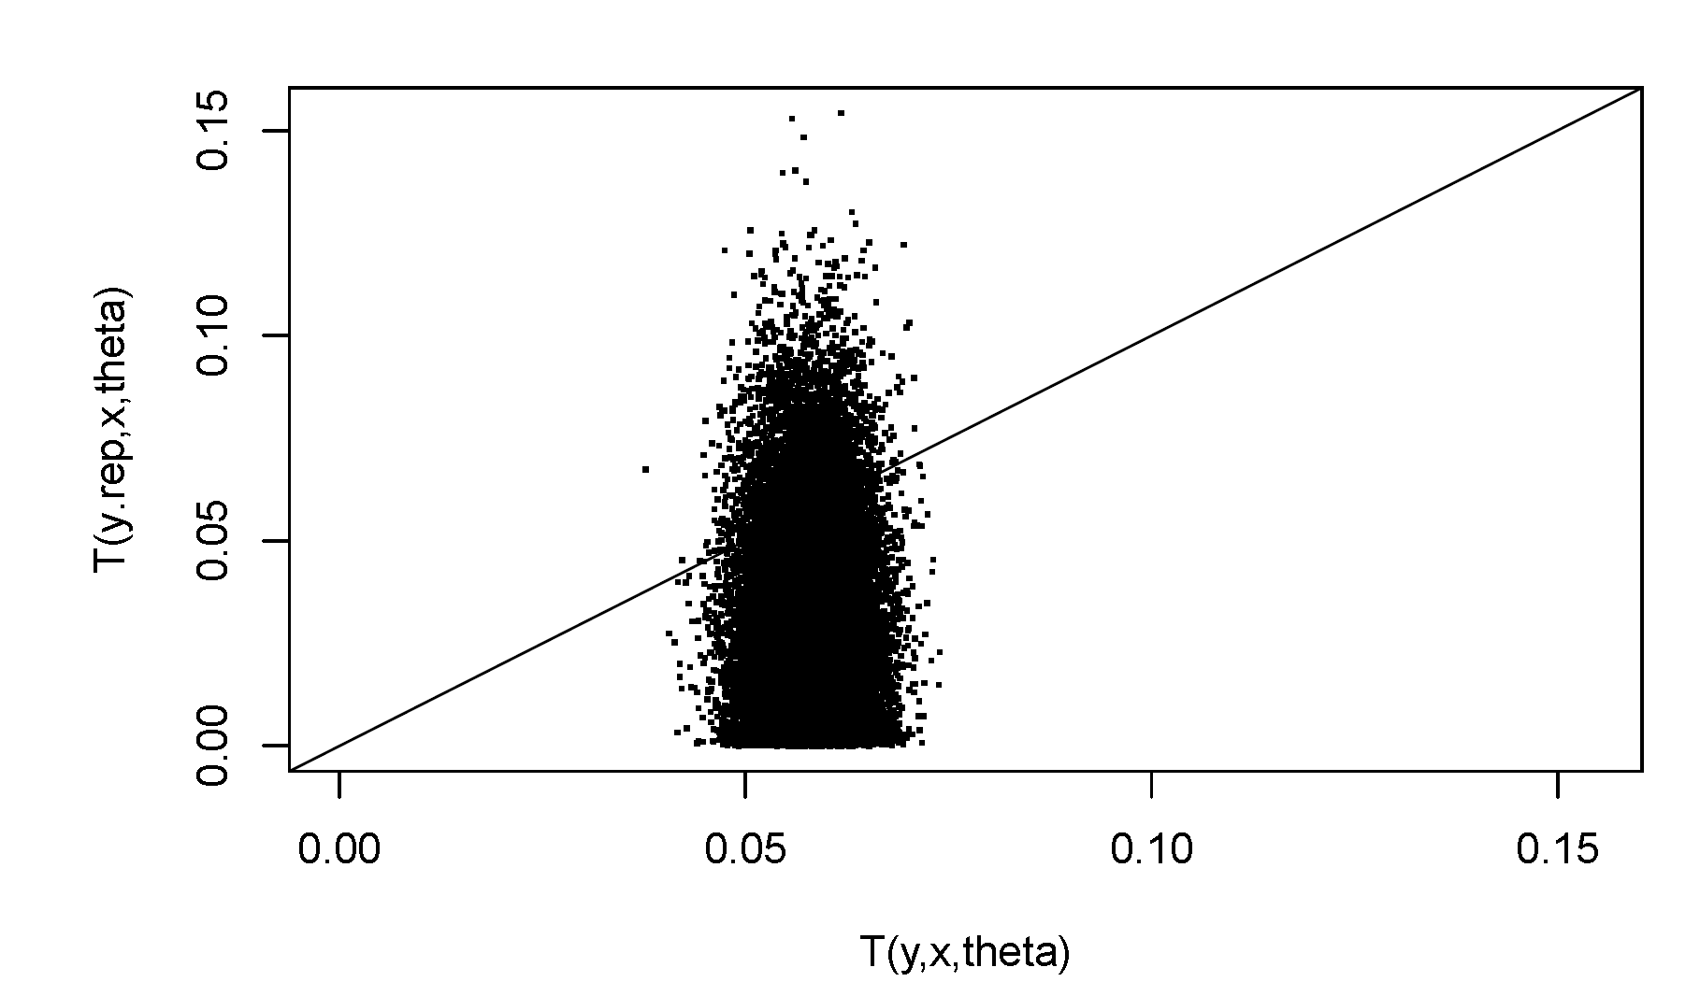
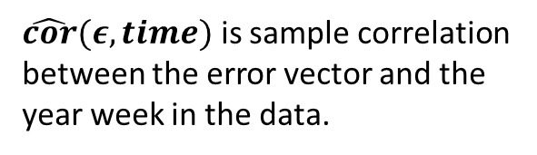
Model Assessment (Cont’d)
Posterior Predictive Check
Temporal Error Correlation Check:
Larger numbers of this test quantity indicate a correlation between errors and time.
The calculated p-value is more than the conventional threshold p-value of 0.05 and therefore, does not indicate any temporal correlation issues in the model.
$\hat{cor}(ε,time)$ is sample correlation between the error vector and the year week in the data.

Slide 19
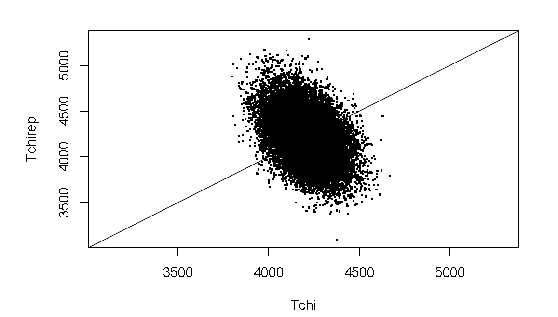
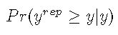
Model Assessment (Cont’d)
Posterior Predictive Check
Chi-Square Discrepancy Check
The calculated p-value using the Chi-Square discrepancy measure is 0.5057 which is more than the conventional threshold p-value of 0.05 and therefore, does not indicate any evidence of issues in the model.
Individual Data Point Discrepancy Check
The posterior predictive p-value using individual data points is 0.5076 which is again greater than 0.05 and therefore, is not indicative of any issues in the model.

Slide 20
Model Assessment (Cont’d)
Posterior Predictive Check
Non-negativity check
For the sake of simplicity, we have decided to use normal distribution instead of Poisson. To investigate whether this simplification has caused any issues, we checked the model for negative predicted y values.
The ratio of the predictions that are less than zero are 0.0463 which is a relatively small number and can justify usage of Normal distribution for simplification.

Slide 21
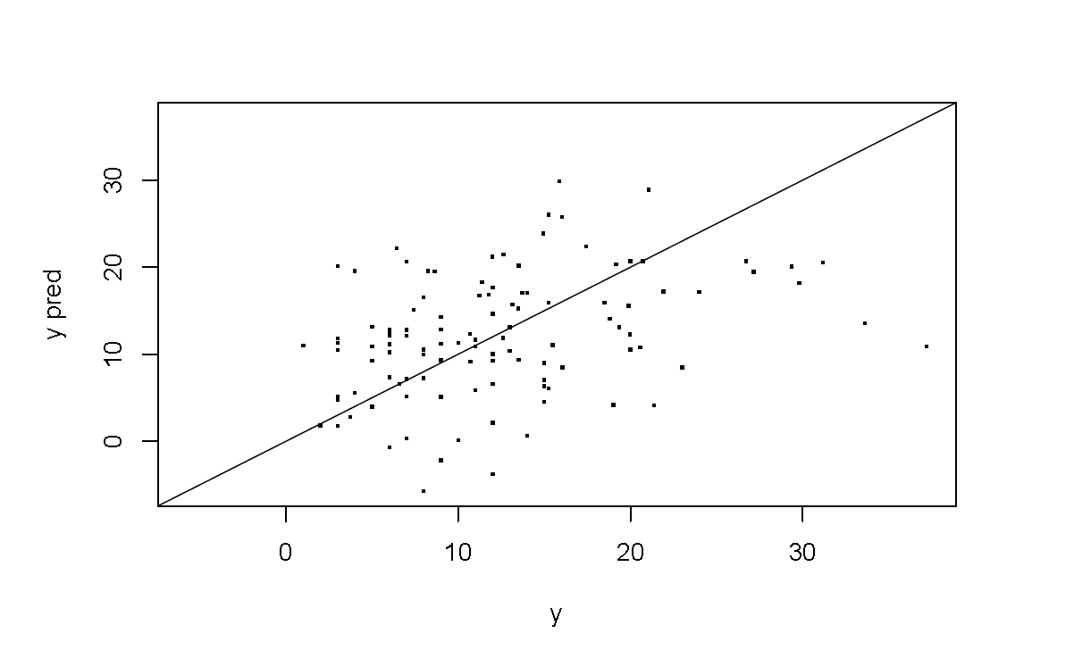
Prediction
As discussed before, we have used the last week of 2016 to test the prediction accuracy of our model.
Prediction of Individual Player Performance
We have tested the model for a random player.
Overall Prediction Effectiveness
To measure the overall prediction effectiveness, we looked at the Pr(y_{rep}>=y) as a posterior p-value.
The result is 0.4683 which is close to 0.5. This implies a relatively good predictive value.
Actual FanDuel Points | 95% Posterior Central Prediction Interval
 | Lower Bound | Higher Bound
7.42 | 4.944 | 27.266

Slide 22
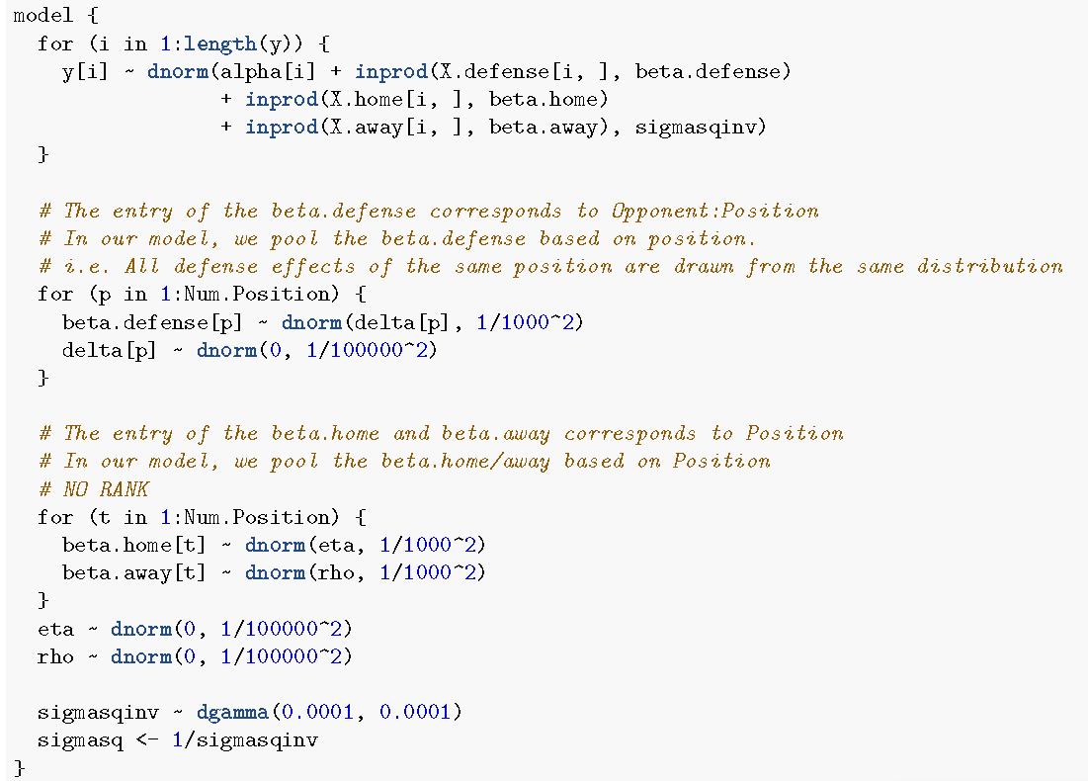
DIC – Alternative model
For the purpose of comparison, we have created an alternative model without considering Rank as a measure.
This model converges (Gelman R_{max}=1.0017<1.1) and all its effective sample sizes are > 400.
However, DIC of the main Model is lower than the alternative model →
“Main model (with Rank) performs better for prediction purposes.”
Model | DIC | Penalty
Main Model | 4719 | 19
Alt. Model | 4781 | 7.02
Main Model
Alt. Model

